Slide 1
Connective Tissue

Slide 2
What are 6 main functions of connective tissue?
Structural framework for body
Transportation of fluids and dissolved substances
Protection of delicate organs
Supports, surrounds, and connects other tissues
Storage of energy in the form of lipids
Defend the body against microorganisms

Slide 3
What are the three main classifications of connective tissue and their subcatagories?
Connective tissue proper
  Loose connective
  Dense connective
Fluid connective tissue
  Blood
  Lymph
Supporting connective tissue
  Cartilage
  Bone

Slide 4
What are the three main categories of connective tissues?
Connective Tissue
Connective tissue proper
Fluid connective tissue
Supporting connective tissue

Slide 5
What are the subcategories of the three main categories of connective tissue?
Connective Tissue
Connective tissue proper
Fluid connective tissue
Supporting connective tissue
Loose connective
tissue
Dense connective
tissue
Blood
Lymph
Cartilage
Bone

Slide 6
What is the general composition and location of the subcategories?
Connective Tissue
Connective tissue proper
Fluid connective tissue
Supporting connective tissue
Loose connective
tissue
Dense connective
tissue
Blood
Lymph
Cartilage
Bone
Fibers create loose, open framework
Fibers densely packed
Contained in circulatory system
Contained in lymphatic system
Solid, rubbery matrix
Solid, crystalline matrix

Slide 7
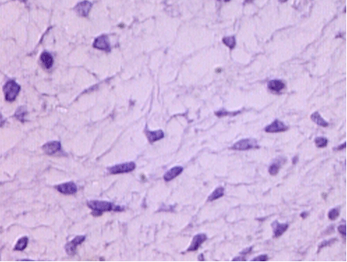
What kind of tissue is this?
Embryonic connective tissue:
Mesenchyme

Slide 8
What are three special features?
Star shaped mesenchymal cell
Gelatinous 3-D matrix material or ground substance

Slide 9
What is its main function?
It gives rise to all other connective tissues

Slide 10
Where is this tissue located?
In the Embryo

Slide 11
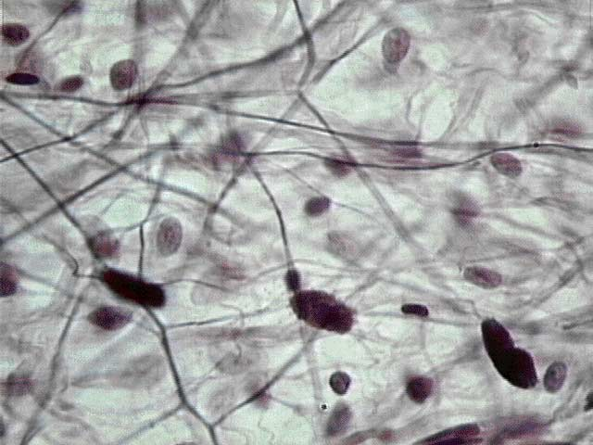
What kind of tissue is this?
Loose connective tissue, a.k.a. areolar connective tissue

Slide 12
What are 4 special features?
Elastic Fibers
Collagen Fibers
Fibroblast nuclei
Macrophages, mast cells, and some white blood cells

Slide 13
What are its 3 main functions?
Surrounds and cushions organs
Secondary defense system below the skin
Transportation and holding of fluids

Slide 14
Where is this tissue located?
Under epithelia (fascia)
Around organs
Surrounding capillaries

Slide 15
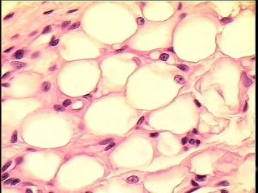
What kind of tissue is this?
Adipose connective tissue

Slide 16
What are 3 special features?
Vacuole containing fat/oil droplets
Nuclei pushed to side of cell
Adipocyte
(fat cell)

Slide 17
What are its 4 main functions?
Insulation
Energy (lipid) reserve
Support and cushioning of organs
Protection of organs

Slide 18
Where is this tissue located?
Hypodermis
Around:
~Kidneys
~Eyeballs
On surface of heart
Female breasts
Hips
Abdominal region

Slide 19
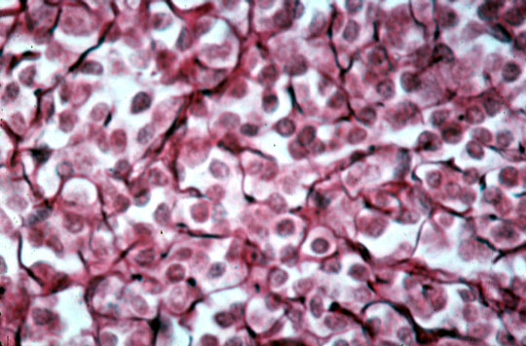
What kind of tissue is this?
Reticular connective tissue

Slide 20
What are 3 special features?
Lymphocyte
3-D matrix of
reticular fibers
Mast cells

Slide 21
What is its main function?
Support of other cell types

Slide 22
Where is this tissue located?
Liver
Spleen
Lymph nodes
Bone marrow

Slide 23
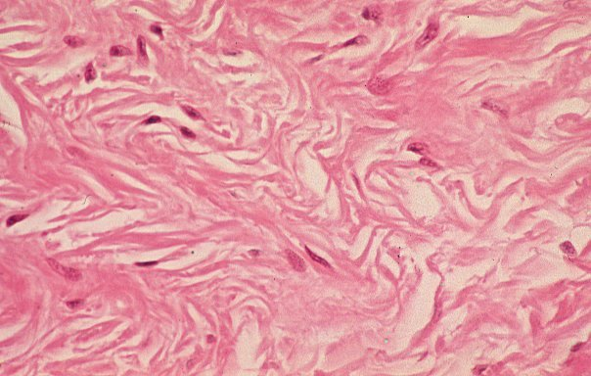
What kind of tissue is this?
Dense white fibrous connective tissue,
irregularly arranged

Slide 24
What are 2 special features?
Fibroblasts
3-D matrix material of 100% interwoven collagen fibers

Slide 25
What are its 4 main functions?
Attachment
Structural strength
Movement
Reduction of friction

Slide 26
Where is this tissue located?
Dermis
Submucosa of digestive tract
Fibrous capsules of organs and joints
Covering skeletal muscle
Nerve and muscle sheaths

Slide 27
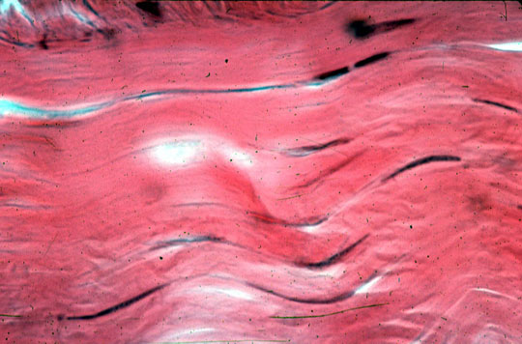
What kind of tissue is this?
Dense white fibrous connective tissue,
regularly-arranged

Slide 28
What are 2 special features?
Fibroblasts make
the collagen fibers
3-D matrix of 100%
collagen fibers

Slide 29
What are its 3 main functions?
Attachment of muscle to bone and bone to bone
Friction reduction
Stabilizing relative bone position

Slide 30
Where is this tissue located?
Tendons
Most ligaments
Aponeurosis
Perichondrium
Periosteum
Deep fasciae

Slide 31
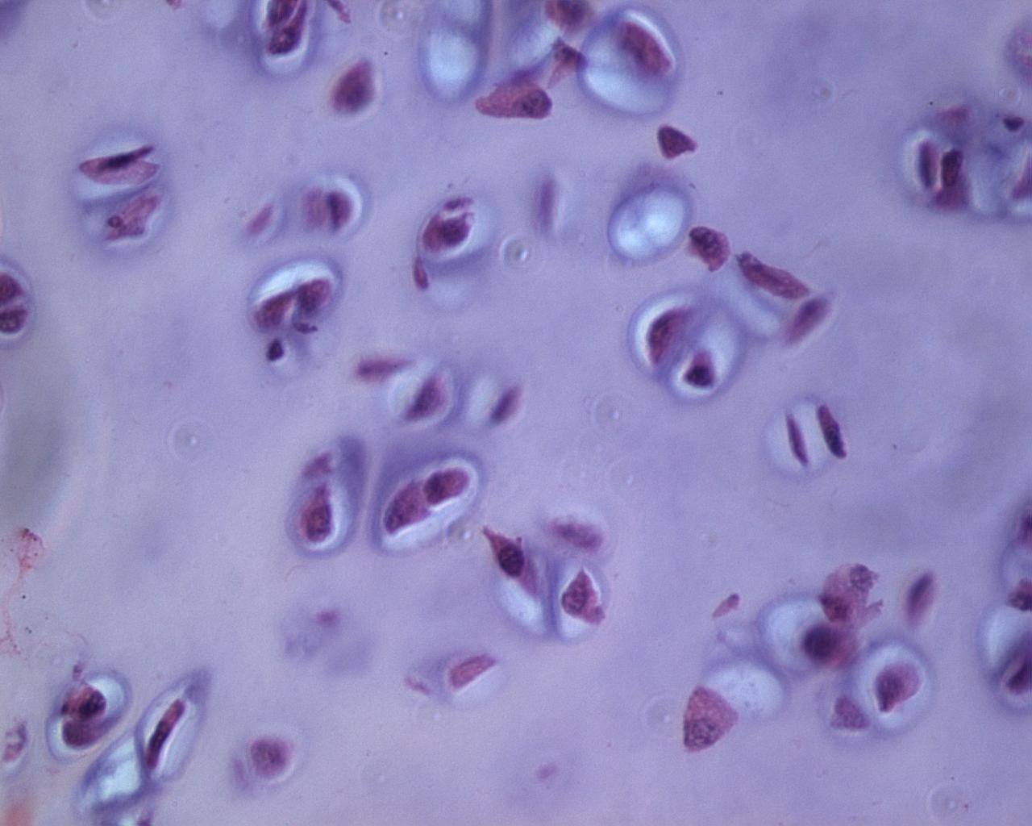
What kind of tissue is this?
Hyaline cartilage

Slide 32
What are 3 special features?
Chondrocyte
Lacuna
3-D matrix of cartilage plus a few collagen fibers

Slide 33
What are its 2 main functions?
Support
Reinforcement

Slide 34
Where is this tissue located?
Embryonic skeleton
End of long bones
(articular cartilages)
Costal cartilages
Cartilage of:
~Nose
~Trachea
~Larynx

Slide 35
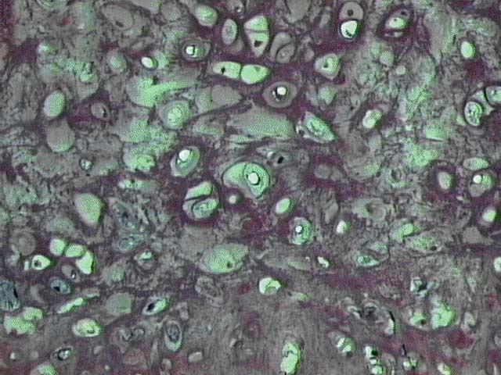
What kind of tissue is this?
Elastic cartilage

Slide 36
What are 3 special features?
Chondrocyte
Lacuna
3D matrix of
Cartilage plus
elastic fibers

Slide 37
What are its 2 main functions?
Maintains shape and structure
Allows flexibility

Slide 38
Where is this tissue located?
External ear
Epiglottis
Auditory canal

Slide 39
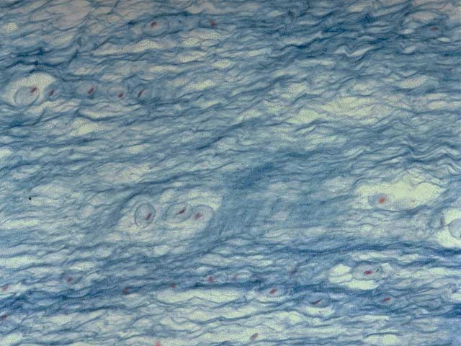
What kind of tissue is this?
Fibrocartilage

Slide 40
What are 4 special features?
Chondrocytes in
lacunae
3-D matrix of
cartilage plus lots
of collagen fibers

Slide 41
What are its 2 main functions?
Strength
Absorption of compressive shock

Slide 42
Where is this tissue located?
Pubis symphysis
Intervertebral discs

Slide 43
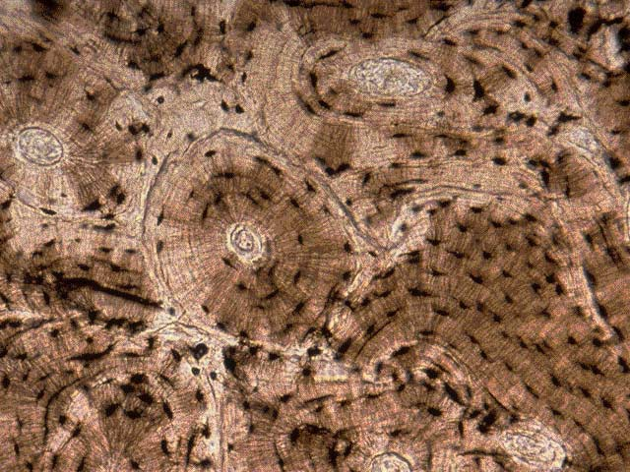
What kind of tissue is this?
Compact bone (osseous tissue)

Slide 44
What are 5 special features?
Carbon skeletons of
osteocytes
Lacunae
Lamellae (layers)
Haversian canal
Canaliculi

Slide 45
What are its 4 main functions?
Support
Protection
Storage of Ca⁺²
Hematopoiesis
(done by
cancellous bone
only)

Slide 46
Where is this tissue located?
Bones

Slide 47
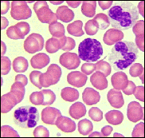
What kind of tissue is this?
Blood

Slide 48
What are 3 special features?
Erythrocytes
(red blood cells)
Leukocytes
(white blood cells)
3-D matrix is liquid
blood plasma

Slide 49
What is its main function?
Transportation of
nutrients, oxygen,
hormones and
wastes

Slide 50
Where is this tissue located?
Within blood vessels

